Slide 1
Business Intelligence for Business Analysts in 2020
Notes:
The concept of Business Intelligence has been around for decades, yet the value it brings to organizations continues to increase year over year. This presentation will review some of the challenges business stakeholders face around information, the importance of Business Intelligence to address those challenges, and some of the expectations and competencies needed for Business Analysts to support Business Intelligence within their organizations.

Slide 2
Our Organization
Notes:
Review the chat window for audience questions.
Do you want to share a little about the Executive Leadership transition at Spectrum Health?
What are some of the local events in our market-space (Priority Advantage, Metro being bought by UofM)

Slide 3
About Me
Dr. Josh Stephens, DHA
IS Director | Enterprise Information Management
Joshua.stephens@spectrumhealth.org
https://www.linkedin.com/in/thejoshstephens/
Notes:
Dr. Josh Stephens, DHA, is the Director of Information Services at Spectrum Health, leading the Enterprise Information Management division at Priority Health. He has been involved in healthcare information management and data governance for almost two decades with experience in revenue cycle management, EDI, cost accounting and decision support, data warehousing and business intelligence, health information exchange, and the practice of data governance. Josh has been married to the love of his life, Rachel, for 15 years, and they have four young children and two big dogs. They have been living in Grand Rapids, Mi. for about 5 years and are members of Grand Rapids Baptist Church (GRBaptist.org). Rachel home-schools the kids, enjoys photography, watercolors, writing, and lately, quilting.

Slide 4
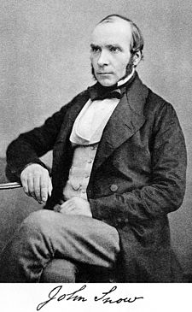
An Example
1854 Broad Street Cholera Outbreak, Dr. John Snow
Notes:
On 31 August 1854, after several other outbreaks had occurred in London, a major outbreak of cholera reached the Soho district. John Snow, called it "the most terrible outbreak of cholera which ever occurred in this kingdom."^{[2]}
Cholera Stats:
Russia from 1850-1860 over 1M people died,
Denmark, 1853 – 4700 people died
Europe, Asia, and North America – over 200k died in the decades prior
Over the next three days, 127 people died. In the next week, three quarters of the residents had fled the area. By 10 September, 500 people had died and the mortality rate was 12.8 percent in some parts of the city. By the end of the outbreak, 616 people had died.

Slide 5
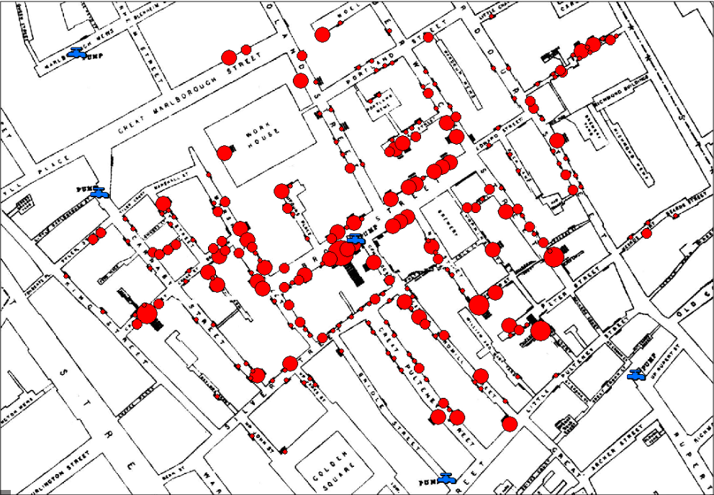
An Example
Notes:
https://en.wikipedia.org/wiki/1854_Broad_Street_cholera_outbreak
Maisma theory – bad air or polution (cholera and Black Death)
Germ theory was not yet established – Louis Pasteur would propose it in 1861
“On proceeding to the spot, I found that nearly all the deaths had taken place within a short distance of the [Broad Street] pump. There were only ten deaths in houses situated decidedly nearer to another street-pump. In five of these cases the families of the deceased persons informed me that they always sent to the pump in Broad Street, as they preferred the water to that of the pumps which were nearer. In three other cases, the deceased were children who went to school near the pump in Broad Street...”
It was discovered later that this public well had been dug only 3 feet (0.9 m) from an old cesspit that had begun to leak fecal bacteria. Nappies used by a baby who had contracted cholera from another source were washed into this cesspit
After the cholera epidemic had subsided, government officials replaced the Broad Street pump handle. They had responded only to the urgent threat posed to the population, and afterwards they rejected Snow's theory. To accept his proposal would have meant indirectly accepting the oral-foecal method of transmission of disease, which was too unpleasant for most of the public to contemplate.
Rev Henry Whitehead worked to disprove John Snow’s theory, but given Snow’s evidence, was convinced that the Broad Street pump was the soure of infections. His work with Snow combined demographic study with scientific observation.

Slide 6
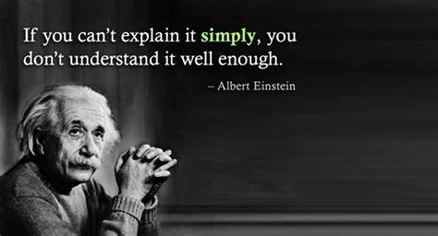
Agenda
Example
Defining the Problem
Defining Business Intelligence
Expectations of the BA/BSA

Slide 7
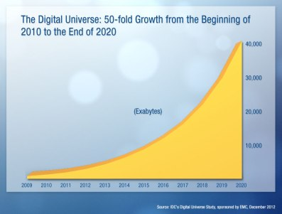
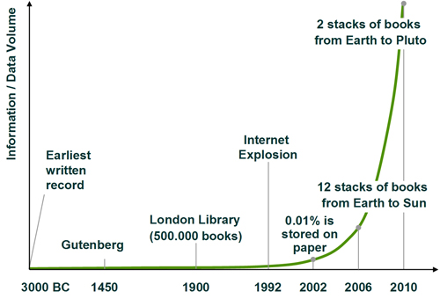
Defining the Problem
The growth of Information, Retrieved 2019, http://www.dlib.org/dlib/may09/mestl/05mestl.html
The growth of Digital Universe, Retrieved 2019, https://theurbantechnologist.com/2013/12/03/information-and-choice-nine-reasons-our-future-is-in-the-balance/

Slide 8
Defining the Problem
EMC’s Digital Universe report shows that in between 2010 and 2012 more information was recorded than in all of previous human history. They predict that the quantity of information recorded will double every 2 years, meaning that at any point in the next two decades it will be true to make the same assertion that “more information was recorded in the last two years than in all of previous history”.
The growth of Digital Universe, Retrieved 2019, https://theurbantechnologist.com/2013/12/03/information-and-choice-nine-reasons-our-future-is-in-the-balance/
The growth of Digital Universe, 2019, https://theurbantechnologist.com/2013/12/03/information-and-choice-nine-reasons-our-future-is-in-the-balance/

Slide 9
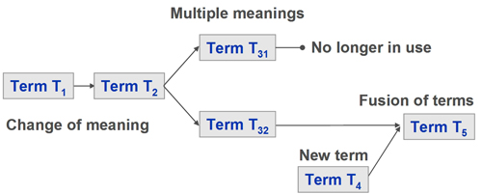
Defining the Problem
One of the problems with data, is that it changes over time. So not only is information growing, the meaning of it is changing as well (e.g. ‘application’, ‘compress’, ‘windows’, Awful’).
The growth of Information, Retrieved 2019, http://www.dlib.org/dlib/may09/mestl/05mestl.html

Slide 10
Defining the Problem
A study done by McKinsey Global Institute in 2011 estimated the value of US Healthcare data to be around 300 Billion dollars, with only 15-20% of the value of that data being realized.
Estimated value of data in healthcare (McKinsey Global Institute, 2011).

Slide 11
Defining the Problem
“We are drowning in information, while starving for wisdom. The world henceforth will be run by synthesizers, people able to put together the right information at the right time, think critically about it, and make important choices wisely.”
~ E. O. Wilson
Notes:
Edward Osborne Wilson (born June 10, 1929), usually cited as E. O. Wilson, is an American biologist, theorist, naturalist and author. His biological specialty is myrmecology, the study of ants, on which he has been called the world's leading expert.

Slide 12
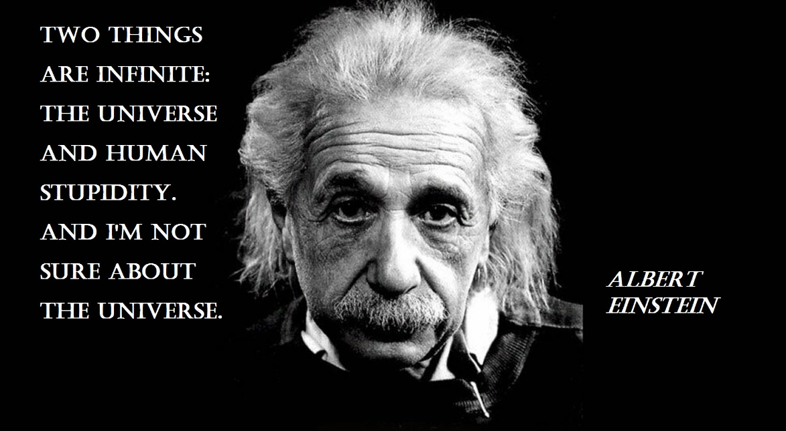
Defining Business Intelligence
Gartner’s Definition: An umbrella term that includes the applications, infrastructure and tools, and best practices that enable access to and analysis of information to improve and optimize decisions and performance. https://www.gartner.com/it-glossary/business-intelligence-bi/
Information: “A quantity that reduces uncertainty about something” (Data Science for Business, 2013).
Notes:
Einstein Quote
Why, Do, What

Slide 13
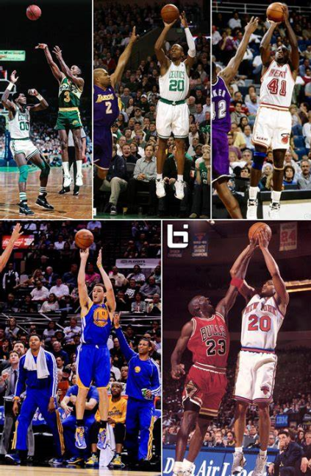
Defining Business Intelligence

Slide 14
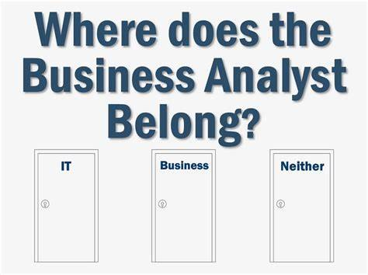
Expectation of the BA/BSA
Know and/or learn the business
Notes:
Hard to do if the IS team you are on focuses on multiple areas of the business
One of the complaints I’ve received on poor performing BSA’s in the past has been “they don’t know our business”

Slide 15
Expectation of the BA/BSA
Know and/or learn the business
Ditto for the “consumer”
Notes:
Hard to do if the IS team you are on focuses on multiple areas of the business

Slide 16
Expectation of the BA/BSA
Know and/or learn the business
Ditto for the “consumer”
Thrive in ambiguity while driving toward clarity
Notes:
Hard to do if the IS team you are on focuses on multiple areas of the business

Slide 17
Expectation of the BA/BSA
Know and/or learn the business
Ditto for the “consumer”
Thrive in ambiguity while driving toward clarity
Consult on Technology and Process
“A business analyst is someone who analyzes the business, looking for ways to improve it… Adding the word “system” to the title of business analyst moves the role into a more technical realm…knows more about application systems and how they support the business needs. A BSA will be able to recommend changes to existing applications, identify impacted interfaces, and work with the technical team to implement and test the changes.
BSAs almost always report to the IT department, whereas BAs may report to a business unit. “
https://rmcls.com/360/ba-business-analyst-bsa-business-systems-analyst-whats-difference/
Notes:
Hard to do if the IS team you are on focuses on multiple areas of the business
It’s not about the sexiness of the technology, it’s about the capabilities and the insights the technology can provide

Slide 18
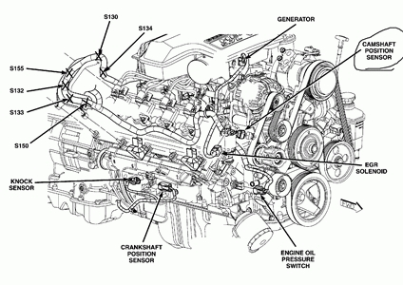
Expectation of the BA/BSA
Know the difference between data, information, and insights
https://carpny.org/wp-content/uploads/2017/10/motor-engine-diagram-dodge-ram-engine-diagram-wiring-diagrams-in-dodge-ram-1500-engine-diagram.gif
https://digital.pixelmotion.com/assets/theme/seo-page-builder/images/2017/Ram/2500/2017%20Ram%202500%20Interior%20Dashboard.jpg
Notes:
Hard to do if the IS team you are on focuses on multiple areas of the business

Slide 19
Expectation of the BA/BSA
Know and/or learn the business
Ditto for the “consumer”
Thrive in ambiguity while driving toward clarity
Consult on Technology and Process
Know the difference between data, information, and insights
Understand data is not all created equal
Notes:
Hard to do if the IS team you are on focuses on multiple areas of the business

Slide 20
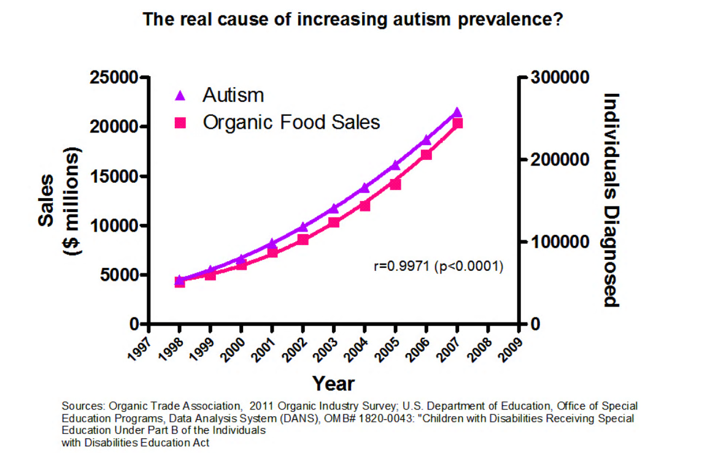
Expectation of the BA/BSA
Visualization and storytelling are co-equal, simplicity & accuracy is paramount.
Notes:
Hard to do if the IS team you are on focuses on multiple areas of the business

Slide 21
Expectation of the BA/BSA
Know and/or learn the business
Ditto for the “consumer”
Thrive in ambiguity while driving toward clarity
Consult on Technology and Process
Know the difference between data, information, and insights
Understand data is not all created equal
Visualization, storytelling, and simplicity are co-equal.
Notes:
Hard to do if the IS team you are on focuses on multiple areas of the business

Slide 22
Discussion
Still haven’t “shown” what BI is.
“We are drowning in information, while starving for wisdom. The world henceforth will be run by Synthesizers, people able to put together the right information at the right time, think critically about it, and [help people] make important choices wisely.”
~ E. O. Wilson

