Slide 1
West Michigan IIBA Event Speaker: Jeff Wheeler Principal and Owner - 85 West Tonite’s sponsor Levi, Ray and Shoup Consulting Annual Sponsors TEKsystems Amway

Slide 2
WM IIBA Future Events
March 19, 2019
Speaker: Travis Foote
Topic: Realistic Agility and the Business Analyst
.

Slide 3
WM IIBA Future Events
May 21, 2019
Panel: Martin Visser, Eric Thompson, Mihaela Popescu, TBD
Topic: Interactive Practical application of Agile practices by BA’s
.

Slide 4
Tonight’s Presentation
Jeff Wheeler serves as the principal and owner of 85 West. He has spent the last decade leading many Fortune 500 companies in solving tomorrow’s technology problems. Most notably, Jeff is best known for serving as Technology Director for ArtPrize.
In 2011, Jeff was part of a startup where he designed and architected a solution for a medical startup, landing as a top 5 finalist in the world for AWS Global startup challenge.
Currently, you can find Jeff serving as a consultant for various organizations, combining his cloud expertise and computational background to build the next generation of AI solutions.

Slide 5
WM IIBA study groups
Certification
Looking at starting
another study group in the fall
.

Slide 6
AWS CLOUD ECONOMICS IS CLOUD COMPUTING RIGHT FOR YOUR BUSINESS?
Jeff Wheeler – Principal @ 85West
Email: Jeff @ 85west.co

Slide 7
Who am I?
^{New Father!}
^{Husband}
^{Technologist}
Focus on enterprise systems and breaking down barriers to innovation

Slide 8
History with AWS
An avid architect since 2010.
2011 AWS Global Startup Challenge Finalist.
Guided the path for automotive, non-profits, advertising, manufacturing and financial industries to using the cloud.

Slide 9
Agenda
How a cloud environment compares to your traditional infrastructure
Understanding around the economics in the Cloud
Introduction to a few key services within AWS
Evaluating business value, ROI and TOC

Slide 10
Provocative questions
Who here has used AWS or another cloud service (e.g. Azure, GCP, AWS)?
Who read an article saying the cloud can save them 90%?
Are part of an organization with a growing customer based outside of the United States?
Have concerns about security or other regulatory compliance needs?
Have had teams estimate the “cost and effort” to move to the cloud?

Slide 11
Economics of the cloud

Slide 12
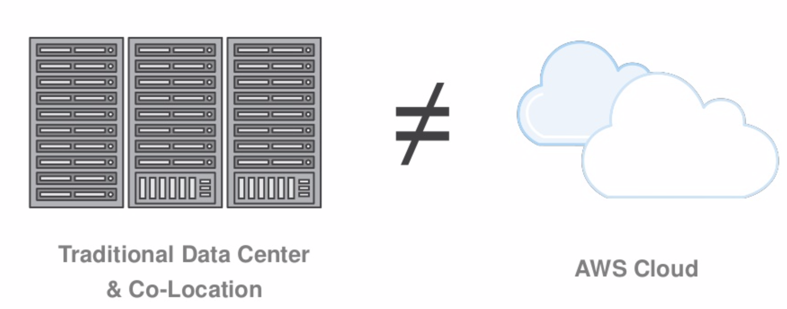

Slide 14
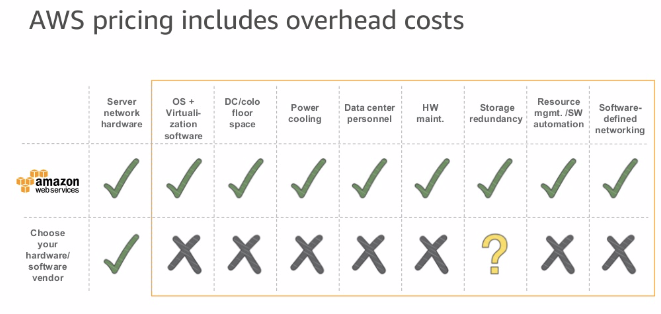

Slide 15
Global Infrastructure

Slide 16
Business Value Tip #1
How are these accounted for in your company?
And, where these accounted for in your original estimate? Likely not.

Slide 17
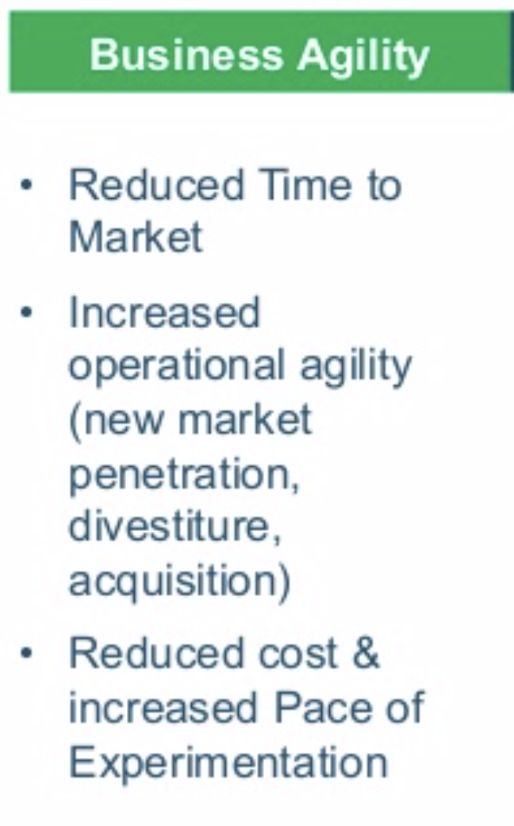
Business Value Tip #2
Agility is commonly overlooked
The ability to respond to your customer and market needs is one of the greatest assets any business can strive towards.

Slide 18
TCO Example
https://awstcocalculator.com

Slide 19
Three AWS Services you must know
Amazon EC2 (VM)
Amazon RDS (Database)
Amazon S3. (Storage)

Slide 20
Amazon EC2
https://aws.amazon.com/ec2/

Slide 21
Amazon RDS
https://aws.amazon.com/rds/

Slide 22
Amazon S3
https://aws.amazon.com/s3/

Slide 23
A Path Forward

Slide 24
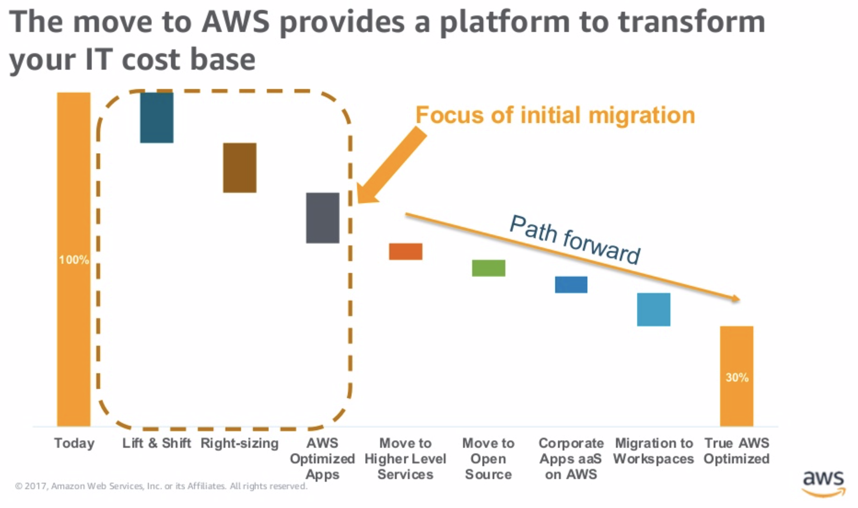

Slide 25
Business Value Tip #3
Swallow. The. Fish.

Slide 26
Q & A

