Slide 1
Business Intelligence for Business Analysts in 2020

Slide 2
About us
Mike Soltis
Director of Network Engagement | Provider Network Analytics
Michael.Soltis@priorityhealth.com
Chris Breen
Supervisor | Provider Network Analytics
Christopher.Breen@priorityhealth.com

Slide 3
Our Organization

Slide 4
Poll #1
How would you best describe your job function(s)?
Business Analysis
Business Systems Analysis
Business Intelligence
Other

Slide 5
Key Objectives
Understand the relationship between BI & BA
Example of “business-grown” analytics
Importance of knowing your business
Understand business processes
Connect to the “why”
Understand your organization’s values
Employ a consultative approach to support

Slide 6
Business Intelligence and Business Analysis
Analytics

Slide 7
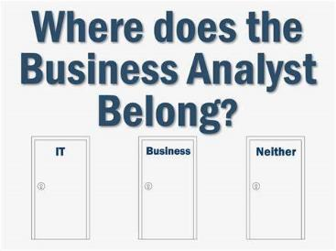
Analytics Organizational Structures
Roles
Business Intelligence
Business Systems Analysis
Business Analysis
Reporting Structures
IT/IS
Business
Neither
Notes:
Business Intelligence professionals seek to help organizations identify where improvements can be made. They are tasked with gathering the data that analysts can then digest and act upon. 1
Business Analysis professionals are tasked with enabling change within an organization by defining needs and formulating solutions for stakeholders. 1
Business Systems Analysis adds a technical component to business analysis. This role encompasses the expertise of the application systems that are used by the business to develop and maintain the data being analyzed. 2
Today we will be talking about the “origin story” of Provider Network Analytics at Priority Health, which began as a business unit which has been repositioned outside of the Business and IT.
1. (https://www.villanovau.com/resources/business-analysis/business-intelligence-business-analysis-critical/)
2. (https://rmcls.com/360/ba-business-analyst-bsa-business-systems-analyst-whats-difference/)

Slide 8
Poll #2
Within your organization, where do you report as an Analyst?
IT/IS
Business
Neither

Slide 9
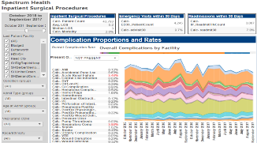
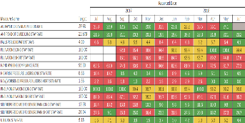
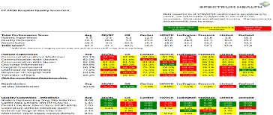
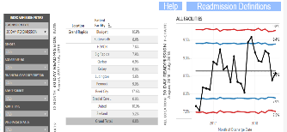
Business Intelligence: How are we doing? Where have we been?
Quantitative
Analysis
Notes:
We have lot’s of data telling us how we are doing
We use this to look back at the past
Limited ability to tell us where our best opportunities are to succeed in the future.

Slide 10
Business Analysis: A Catalyst for Proactive Improvement of Outcomes
Creates understanding around key questions:
Who is likely to have poor outcomes in the future?
Why are they likely to have poor outcomes?
Where are the best opportunities to improve their outcomes?
What needs to be done and by whom?
Is what we are doing delivering the outcomes we desire?

Slide 11
Analytics Maturity Model
Business Analytics’ “Sweet Spot”

Slide 12
Building a foundation for the healthcare Value
Percent of revenue tied to value
Incentives and Penalties
CPC+, APMs, Gain Share
ACOs and Full Risk
Notes:
We appreciate that payment reform is coming…

Slide 13
The Provider Division at Priority Health
Provider Contracting
&
Network
Performance
Ancillary Contracting
Provider Communications
Provider Operations
Provider Enrollment
Provider Credentialing
Provider Reimbursement
Payment Integrity
Provider Network Analytics
Notes:
Provider Data and Provider Network could be considered PH’s product. Network of quality providers that serve our members needs

Slide 14
Origin of Provider Network Analytics (previously reporting to Business Units)
Provider Network Analytics
Provider Operations Support
Financial Analytics
Reimbursement Configuration
Data Engineering & Data Science
Notes:
Previously reported to business units – now reporting to executive leadership.

Slide 15
Analytics at the Core
Data-driven Strategy & decision making
Proactive operational enhancements
Value focused vision
Continuity
Increased Collaboration
Greater coordination & transparency
Reduced touchpoints
Finance
Legal / Regulatory
Business Analytics
Value Based Operations
Value Based Operations
Operations
Value Based Operations

Slide 16
Third Party Perspective to Specialized Analytics
Tie the needs of individual business units to the strategic priorities of senior leadership.
Applied subject-matter expertise
Dedicated technical resources
Neutral perspective – shared accountability
Centralized Analytics – broader exposure to divisional data

Slide 17
The Function of Provider Network Analytics
Business Intelligence and Business Analytics
Cost-savings analysis
Regulatory reporting
Data quality analysis
Business Systems Analysis and Administration
System support
System enhancement
Operational Process Improvement
Data Engineering
Automation of reporting processes
Data architecture
Collaboration with IS development
Ownership and coordination of strategic provider information initiatives
Consultative Analytical Support
Notes:
Chris - Current Functions

Slide 18
Provider Data Flow

Slide 19
Provider Data Flow
BSA

Slide 20
Provider Data Flow
Information Systems
Notes:
PNA BI / Engineering informing IS architecture development in an advisory role

Slide 21
Provider Data Flow
Business Intelligence Department Side

Slide 22
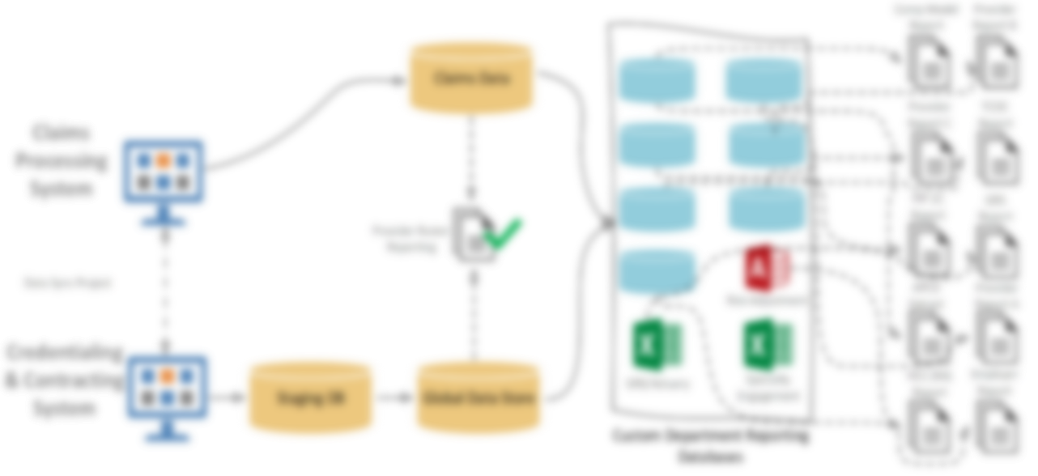
Provider Data Flow
IT & Data Engineering
BSA
Feedback Loop
BI / BA
Notes:
Meet the organization’s provider reporting needs. Many use cases that influence data sourcing.

Slide 23
Poll #3
Can you confidently say you know how much it will cost when you go to the Doctor?
Yes
No

Slide 24
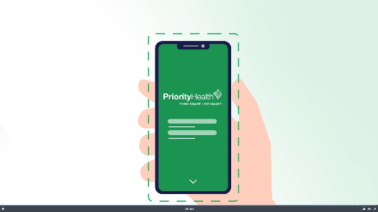
Example – Priority Health’s Cost Estimator
Notes:
BSA role
Bi
Specialization

Slide 25
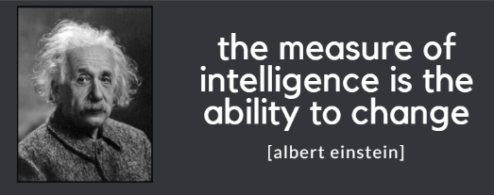
No Pain No Gain
Change management
Roles
Reporting structure
Managing customer base expectations
Increased need for collaboration with IT
Increased scope of work and demand
Need for greater transparency

Slide 26
Tips for Getting to Know Your Business
Avoid solutioning before listening
See for yourself
View processes or problems in the customer’s setting
Understand the value of your work
Why is this important to the business?
Gain trust through transparency
Frequent communication

Slide 27
Summary
Importance of BI to Business Analysis
Where have we been? Where are we now? Where are we going?
Regardless of reporting structure, make it a goal to do the following:
Know the business
Connect to the “why”
Understand your org’s values
Consultative approach to support
Notes:
Compassion, Collaboration, Curiosity, Courage.

Slide 28
Thank You! Q & A

